Slide 1
Principles of International Finance and Open Economy Macroeconomics
Cristina Terra

Slide 2
Chapter 6
Money and Exchange Rate in the Long-Run
Cristina Terra

Slide 3
Introduction
Long-run: a period defined as that which allows the complete adjustment of goods prices to economic shocks.
  the prices of goods are completely flexible.
Main consequence of price flexibility: the current account is always at its optimum level, with the real exchange rate at its equilibrium level
The focus of this model is the money market and the analysis of the impact of monetary shocks.

Slide 4
Plan
Money, Assets, and Goods Markets
  Money Market
  Assets Market
  Goods Market
Exchange Rate Fundamentals
  Constant Fundamentals
  Fundamentals Increasing at a Constant Rate
  Fundamentals That Increase and Then Remain Constant
Applications, Extensions, and Limits of the Model

Slide 5
Plan
Money, Assets, and Goods Markets
  Money Market
  Assets Market
  Goods Market
Exchange Rate Fundamentals
  Constant Fundamentals
  Fundamentals Increasing at a Constant Rate
  Fundamentals That Increase and Then Remain Constant
Applications, Extensions, and Limits of the Model

Slide 6
Money, Assets and Goods Markets
Open economy: the interaction of six markets:
  the domestic and foreign money markets,
  the domestic and foreign assets markets,
  and the domestic and foreign goods markets.
Let us see the assumption on each of them
Money market
Money supply: a government decision, more precisely, that of the central bank, we will take it as an exogenous variable.

Slide 7
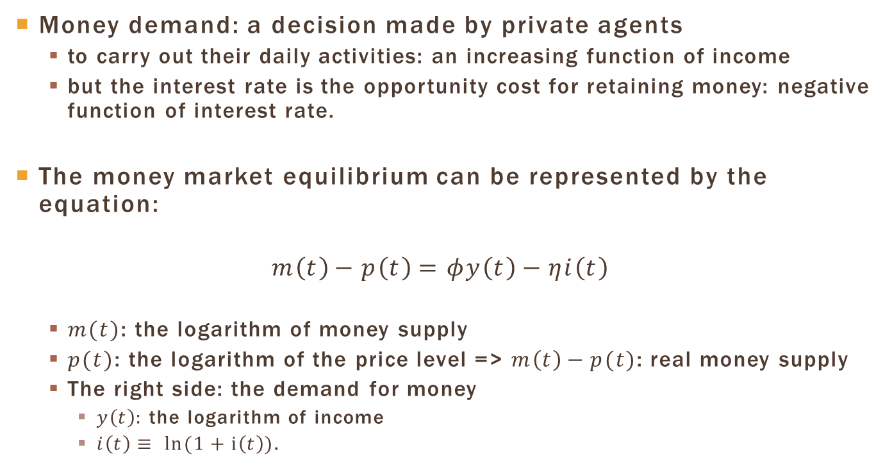
Money Market
Money demand: a decision made by private agents
  to carry out their daily activities: an increasing function of income
  but the interest rate is the opportunity cost for retaining money: negative function of interest rate.
The money market equilibrium can be represented by the equation:
$$m\left(t\right)−p\left(t\right)=φy\left(t\right)−ηi\left(t\right)$$
  $m(t)$: the logarithm of money supply
  $p(t)$: the logarithm of the price level => $m\left(t\right)−p(t)$: real money supply
  The right side: the demand for money
    $y\left(t\right):$ the logarithm of income
    $i\left(t\right)≡ ln(1+i\left(t\right))$.

Slide 8
Money Market
Small, open economy => the domestic variables do not have an influence on foreign variables.
Therefore, the variables referent to other countries are taken as givens, and the functioning of their economy is not modeled.
We just take the foreign interest rate as an exogenous variables.

Slide 9
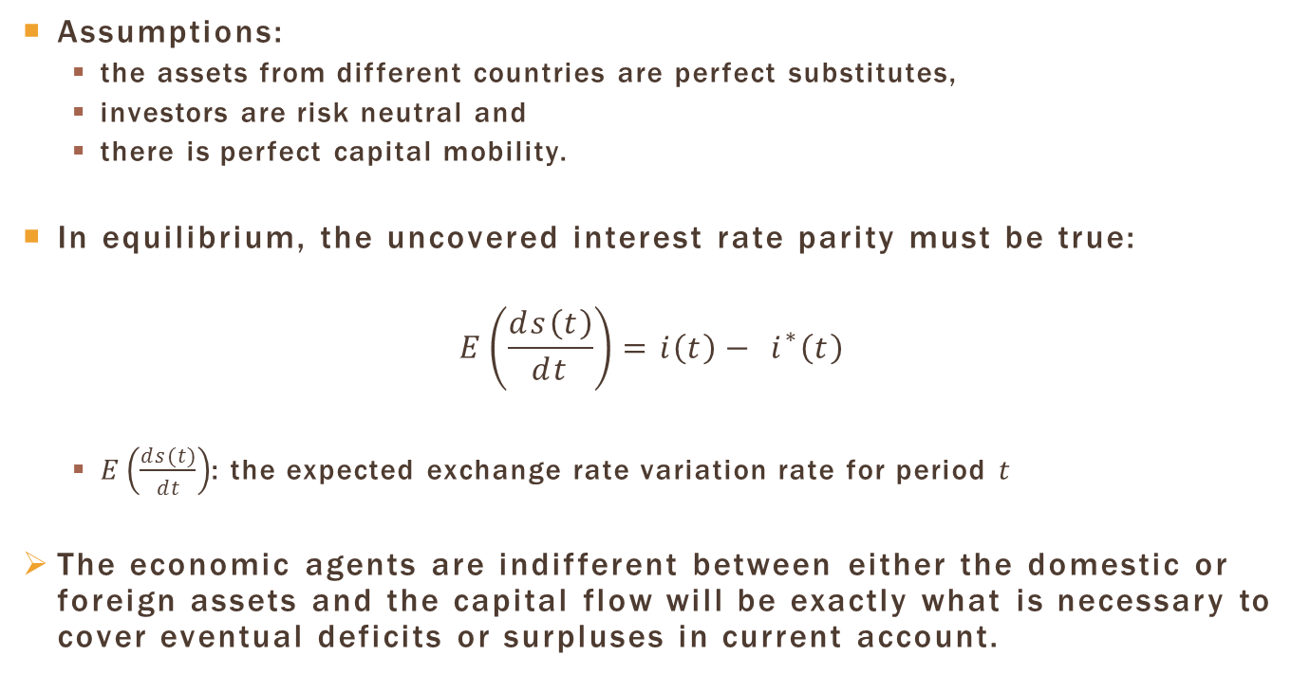
Asset Market
Assumptions:
  the assets from different countries are perfect substitutes,
  investors are risk neutral and
  there is perfect capital mobility.
In equilibrium, the uncovered interest rate parity must be true:
$$E\left(\frac{ds\left(t\right)}{dt}\right)=i\left(t\right)− i^{∗}\left(t\right)$$
  $E\left(\frac{ds(t)}{dt}\right)$: the expected exchange rate variation rate for period $t$
The economic agents are indifferent between either the domestic or foreign assets and the capital flow will be exactly what is necessary to cover eventual deficits or surpluses in current account.

Slide 10
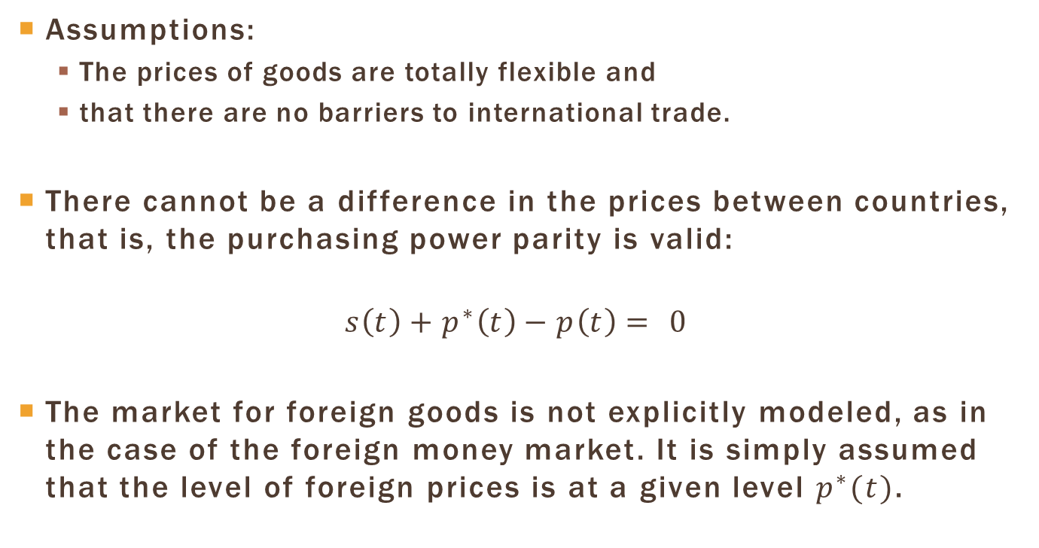
Goods Market
Assumptions:
  The prices of goods are totally flexible and
  that there are no barriers to international trade.
There cannot be a difference in the prices between countries, that is, the purchasing power parity is valid:
$$s\left(t\right)+p^{∗}\left(t\right)−p\left(t\right)= 0$$
The market for foreign goods is not explicitly modeled, as in the case of the foreign money market. It is simply assumed that the level of foreign prices is at a given level $p^{∗}(t)$.

Slide 11
Plan
Money, Assets, and Goods Markets
  Money Market
  Assets Market
  Goods Market
Exchange Rate Fundamentals
  Constant Fundamentals
  Fundamentals Increasing at a Constant Rate
  Fundamentals That Increase and Then Remain Constant
Applications, Extensions, and Limits of the Model

Slide 12
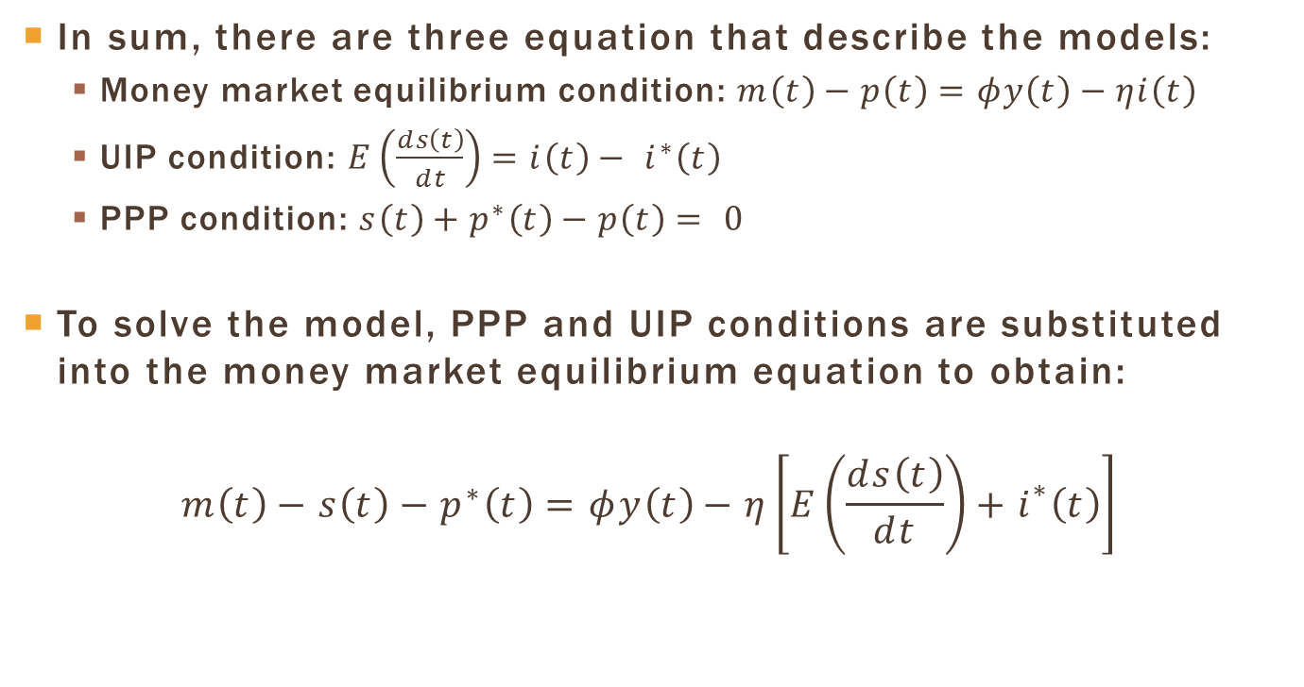
Exchange Rate Fundamentals
In sum, there are three equation that describe the models:
  Money market equilibrium condition: $m\left(t\right)−p\left(t\right)=φy\left(t\right)−ηi\left(t\right)$
  UIP condition: $E\left(\frac{ds\left(t\right)}{dt}\right)=i\left(t\right)− i^{∗}\left(t\right)$
  PPP condition: $s\left(t\right)+p^{∗}\left(t\right)−p\left(t\right)= 0$
To solve the model, PPP and UIP conditions are substituted into the money market equilibrium equation to obtain:
$$m\left(t\right)−s\left(t\right)−p^{∗}\left(t\right)=φy\left(t\right)−η\left[E\left(\frac{ds\left(t\right)}{dt}\right)+i^{∗}\left(t\right)\right]$$

Slide 13
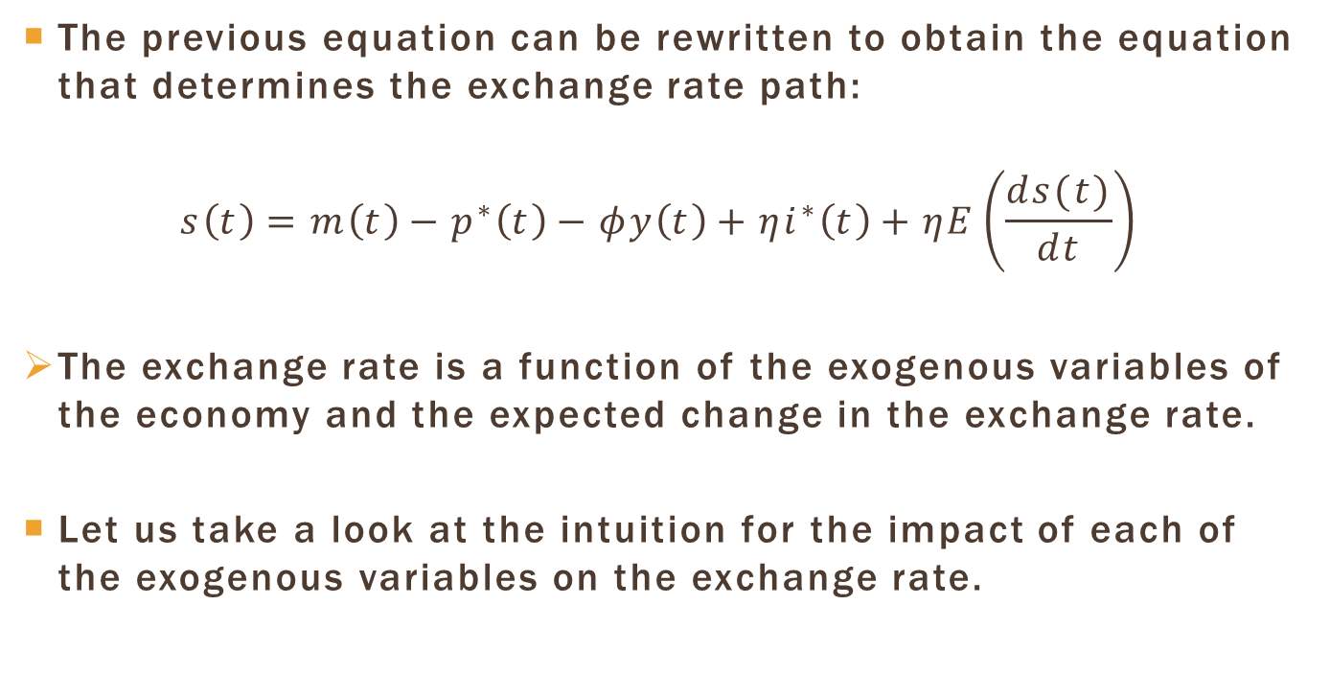
Exchange Rate Fundamentals
The previous equation can be rewritten to obtain the equation that determines the exchange rate path:
$$s\left(t\right)=m\left(t\right)−p^{∗}\left(t\right)−φy\left(t\right)+ηi^{∗}\left(t\right)+ηE\left(\frac{ds(t)}{dt}\right)$$
The exchange rate is a function of the exogenous variables of the economy and the expected change in the exchange rate.
Let us take a look at the intuition for the impact of each of the exogenous variables on the exchange rate.

Slide 14
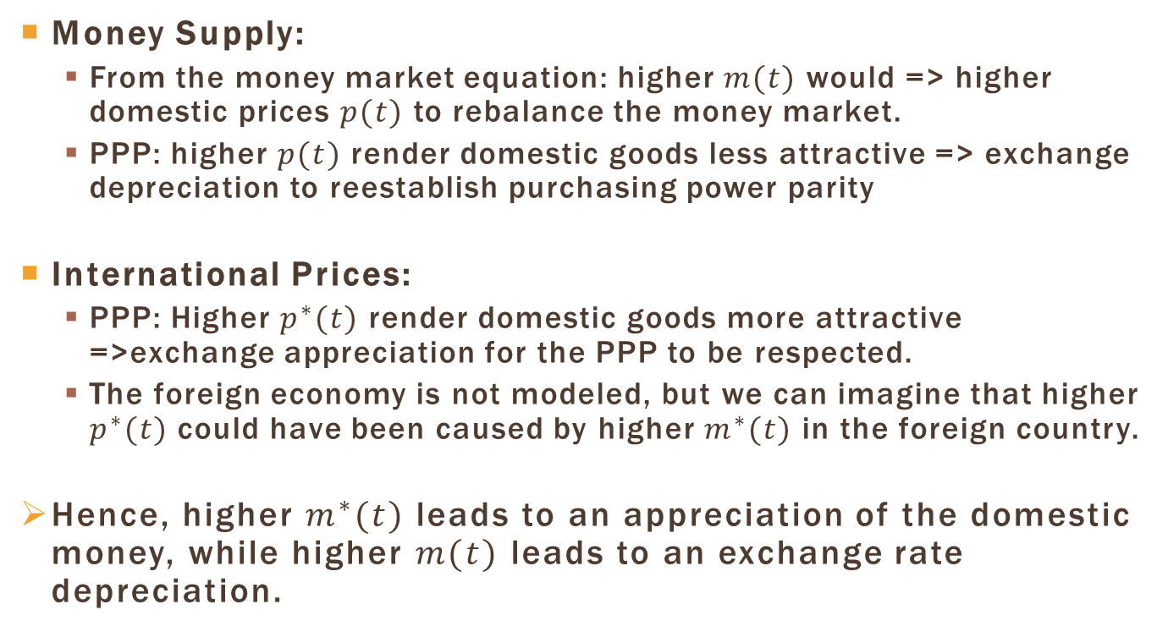
Exchange Rate Fundamentals
Money Supply:
  From the money market equation: higher $m(t)$ would => higher domestic prices $p(t)$ to rebalance the money market.
  PPP: higher $p(t)$render domestic goods less attractive => exchange depreciation to reestablish purchasing power parity
International Prices:
  PPP: Higher $p^{∗}(t)$ render domestic goods more attractive =>exchange appreciation for the PPP to be respected.
  The foreign economy is not modeled, but we can imagine that higher $p^{∗}(t)$ could have been caused by higher $m^{∗}(t)$ in the foreign country.
Hence, higher $m^{∗}(t)$leads to an appreciation of the domestic money, while higher $m(t)$ leads to an exchange rate depreciation.

Slide 15
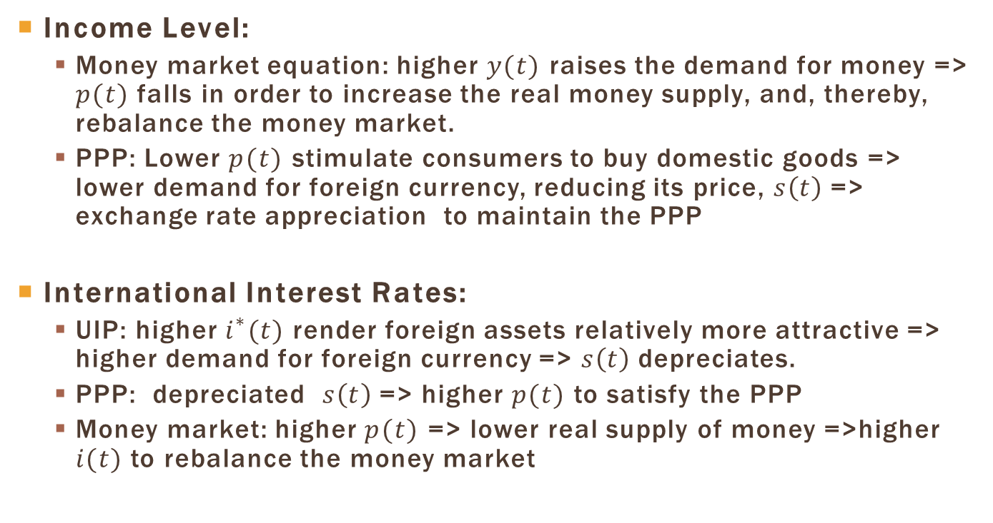
Exchange Rate Fundamentals
Income Level:
  Money market equation: higher $y(t)$ raises the demand for money => $p(t)$ falls in order to increase the real money supply, and, thereby, rebalance the money market.
  PPP: Lower $p(t)$ stimulate consumers to buy domestic goods => lower demand for foreign currency, reducing its price, $s\left(t\right)$ => exchange rate appreciation to maintain the PPP
International Interest Rates:
  UIP: higher $i^{∗}(t)$ render foreign assets relatively more attractive => higher demand for foreign currency => $s\left(t\right)$ depreciates.
  PPP: depreciated $s\left(t\right)$ => higher $p(t)$ to satisfy the PPP
  Money market: higher $p(t)$ => lower real supply of money =>higher $i(t)$ to rebalance the money market

Slide 16
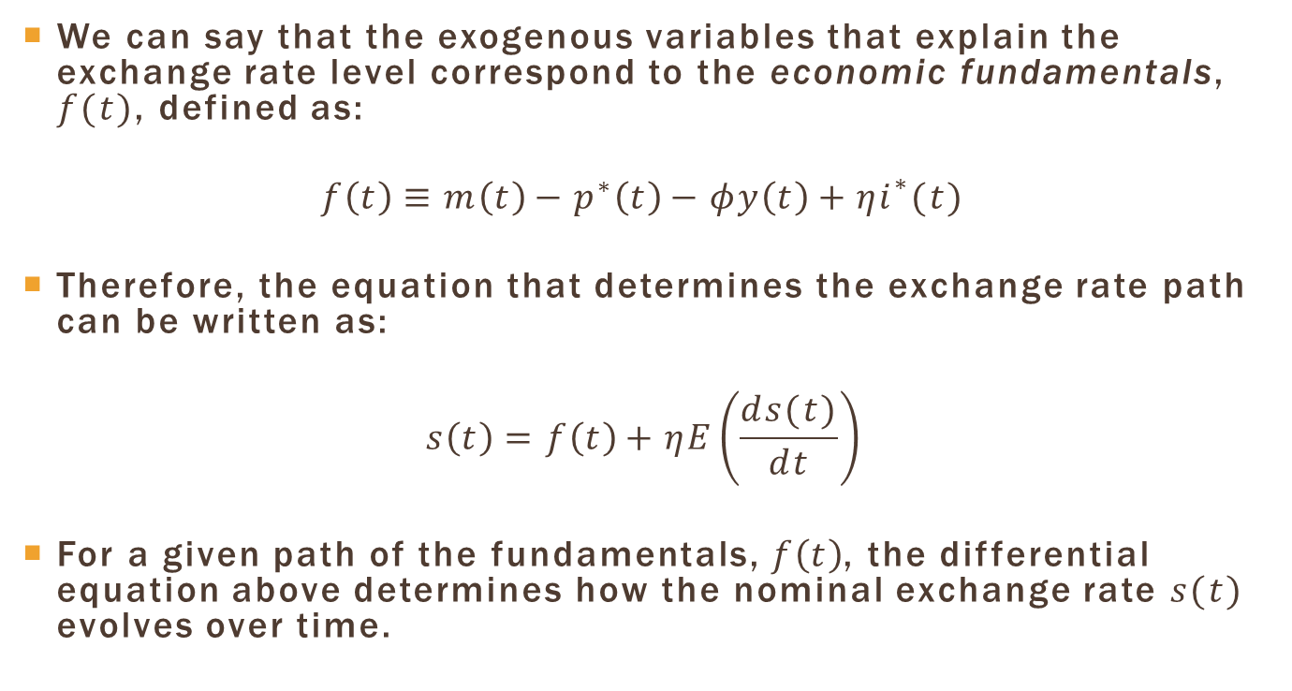
Exchange Rate Fundamentals
We can say that the exogenous variables that explain the exchange rate level correspond to the economic fundamentals, $f(t)$, defined as:
$$f\left(t\right)≡m\left(t\right)−p^{∗}\left(t\right)−φy\left(t\right)+ηi^{∗}(t)$$
Therefore, the equation that determines the exchange rate path can be written as:
$$s\left(t\right)=f\left(t\right)+ηE\left(\frac{ds(t)}{dt}\right)$$
For a given path of the fundamentals, $f\left(t\right)$, the differential equation above determines how the nominal exchange rate $s(t)$ evolves over time.

Slide 17
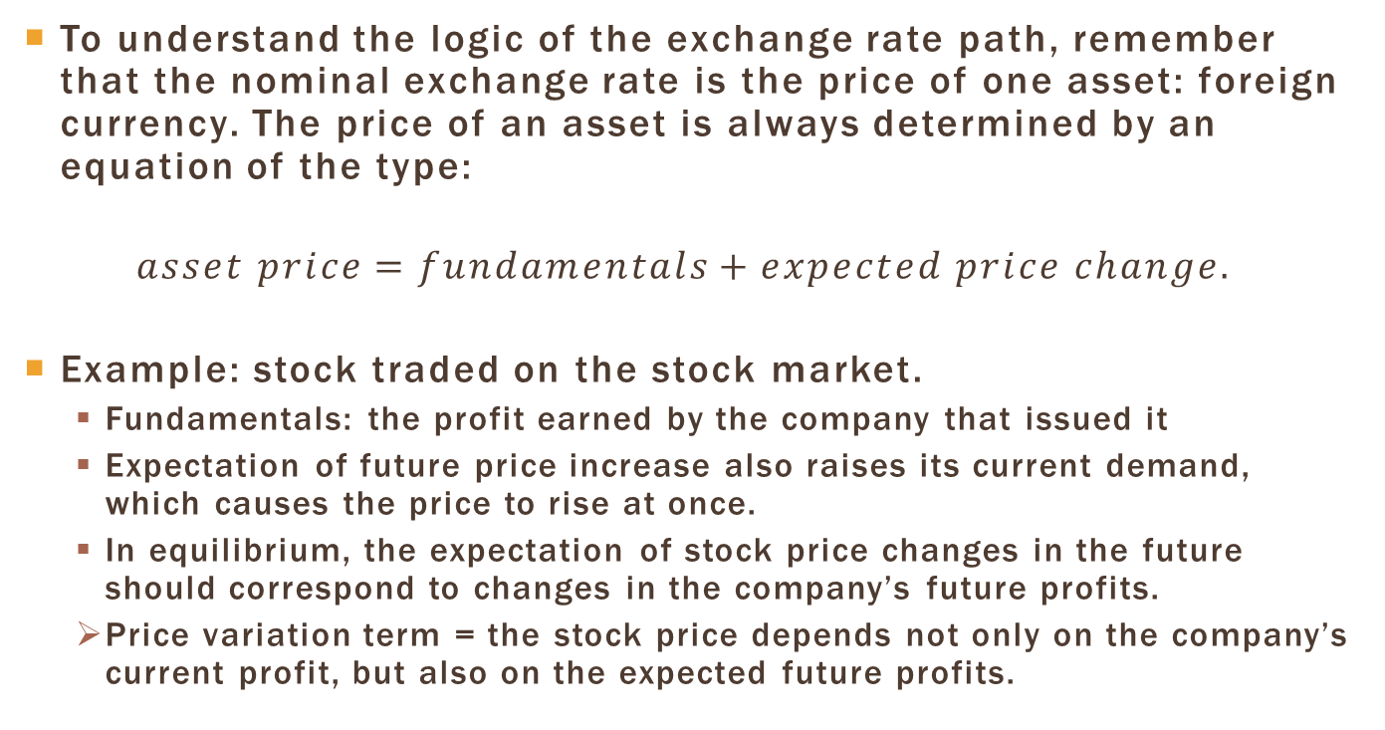
Exchange Rate: an Asset
To understand the logic of the exchange rate path, remember that the nominal exchange rate is the price of one asset: foreign currency. The price of an asset is always determined by an equation of the type:
$$asset price=fundamentals+expected price change.$$
Example: stock traded on the stock market.
  Fundamentals: the profit earned by the company that issued it
  Expectation of future price increase also raises its current demand, which causes the price to rise at once.
  In equilibrium, the expectation of stock price changes in the future should correspond to changes in the company’s future profits.
  Price variation term = the stock price depends not only on the company’s current profit, but also on the expected future profits.

Slide 18
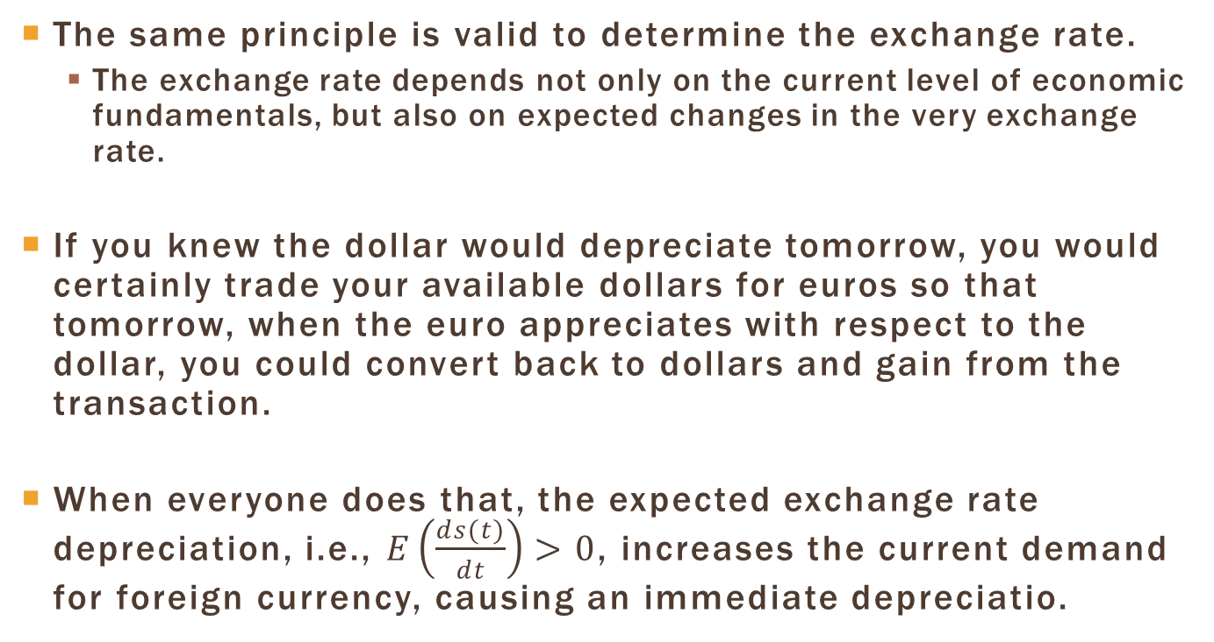
Expectations and the Exchange Rate
The same principle is valid to determine the exchange rate.
  The exchange rate depends not only on the current level of economic fundamentals, but also on expected changes in the very exchange rate.
If you knew the dollar would depreciate tomorrow, you would certainly trade your available dollars for euros so that tomorrow, when the euro appreciates with respect to the dollar, you could convert back to dollars and gain from the transaction.
When everyone does that, the expected exchange rate depreciation, i.e., $E\left(\frac{ds(t)}{dt}\right)>0$, increases the current demand for foreign currency, causing an immediate depreciatio.

Slide 19
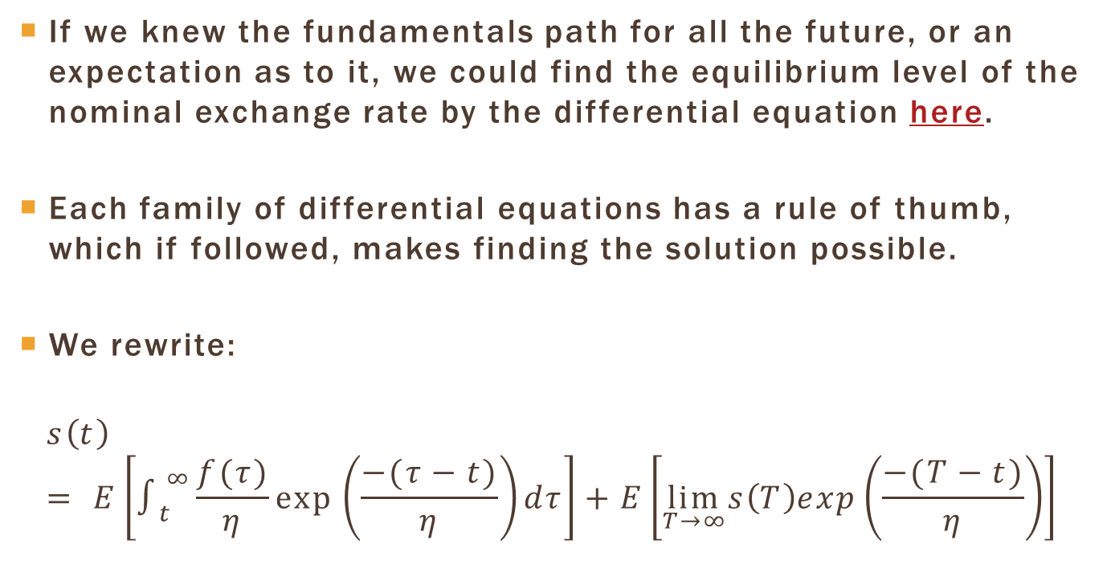
Exchange Rate: Solving the Differential Equation
If we knew the fundamentals path for all the future, or an expectation as to it, we could find the equilibrium level of the nominal exchange rate by the differential equation here.
Each family of differential equations has a rule of thumb, which if followed, makes finding the solution possible.
We rewrite:
$$s\left(t\right)= E\left[∫_{t}^{∞}\frac{f(τ)}{η}exp⁡\left(\frac{−(τ−t)}{η}\right)dτ\right]+E\left[\lim_{T→∞}s\left(T\right)exp\left(\frac{−(T−t)}{η}\right)\right]$$

Slide 20
Exchange Rate: Solving the Differential Equation
If we knew the fundamentals path for all the future, or an expectation as to it, we could find the equilibrium level of the nominal exchange rate by the differential equation here.
Each family of differential equations has a rule of thumb, which if followed, makes finding the solution possible.
We rewrite:
$$s\left(t\right)= E\left[∫_{t}^{∞}\frac{f(τ)}{η}exp⁡\left(\frac{−(τ−t)}{η}\right)dτ\right]+E\left[\lim_{T→∞}s\left(T\right)exp\left(\frac{−(T−t)}{η}\right)\right]$$

Slide 21
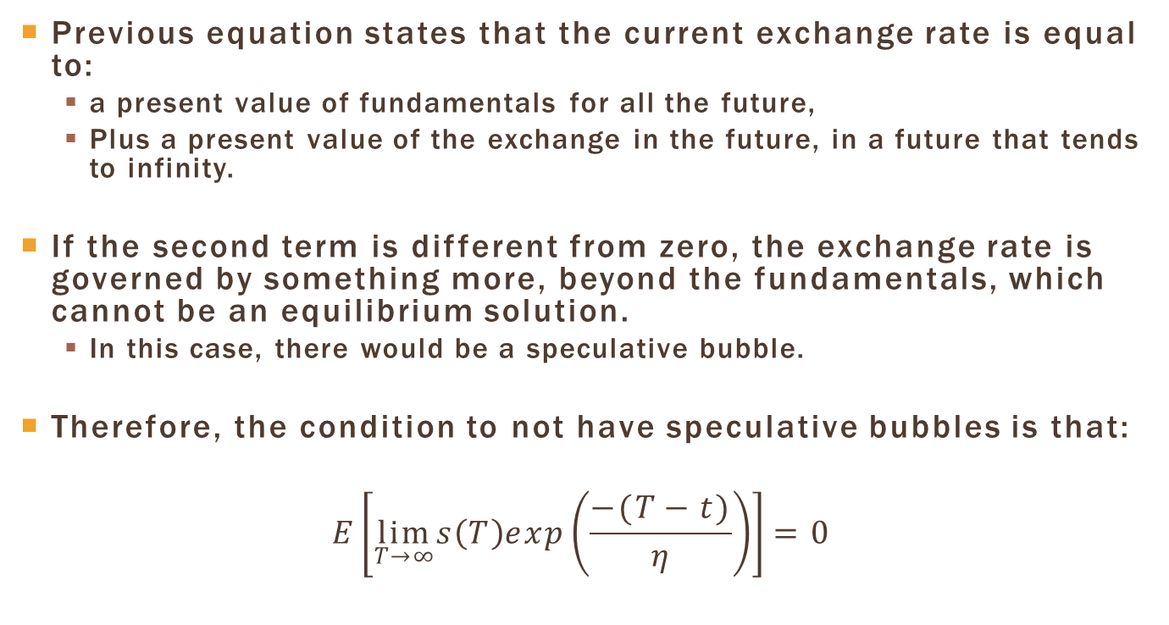
No Bubble Condition
Previous equation states that the current exchange rate is equal to:
  a present value of fundamentals for all the future,
  Plus a present value of the exchange in the future, in a future that tends to infinity.
If the second term is different from zero, the exchange rate is governed by something more, beyond the fundamentals, which cannot be an equilibrium solution.
  In this case, there would be a speculative bubble.
Therefore, the condition to not have speculative bubbles is that:
$$E\left[\lim_{T→∞}s\left(T\right)exp\left(\frac{−(T−t)}{η}\right)\right]=0$$

Slide 22
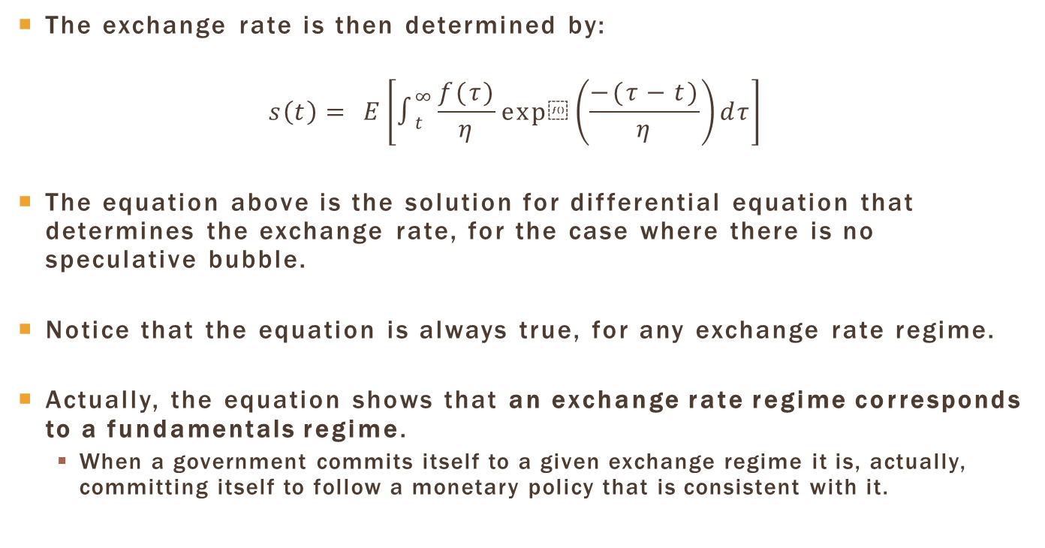
Exchange Rate: Solution
The exchange rate is then determined by:
$$s\left(t\right)= E\left[∫_{t}^{∞}\frac{f(τ)}{η}exp⁡\left(\frac{−(τ−t)}{η}\right)dτ\right]$$
The equation above is the solution for differential equation that determines the exchange rate, for the case where there is no speculative bubble.
Notice that the equation is always true, for any exchange rate regime.
Actually, the equation shows that an exchange rate regime corresponds to a fundamentals regime.
  When a government commits itself to a given exchange regime it is, actually, committing itself to follow a monetary policy that is consistent with it.

Slide 23
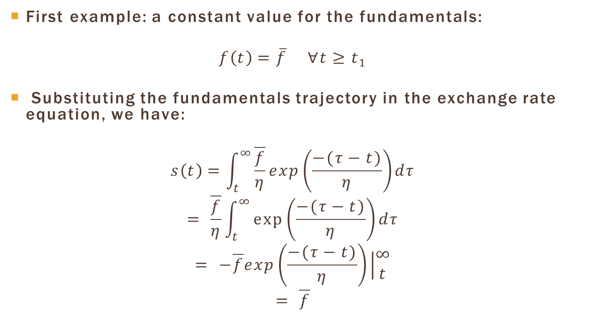
Example: Constant Fundamentals
First example: a constant value for the fundamentals:
$$f\left(t\right)=\overline{f} ∀t≥t_{1}$$
Substituting the fundamentals trajectory in the exchange rate equation, we have:
$$s\left(t\right)=\int_{t}^{∞}{\frac{\overline{f}}{η}}exp\left(\frac{−(τ−t)}{η}\right)dτ$$
$$= \frac{\overline{f}}{η}\int_{t}^{∞}{\exp\left(\frac{−(τ−t)}{η}\right)dτ}$$
$$= −\overline{f}exp\left(\frac{−(τ−t)}{η}\right)\left|\begin{matrix}∞ \\ t\end{matrix}\right.$$
$$= \overline{f}$$

Slide 24
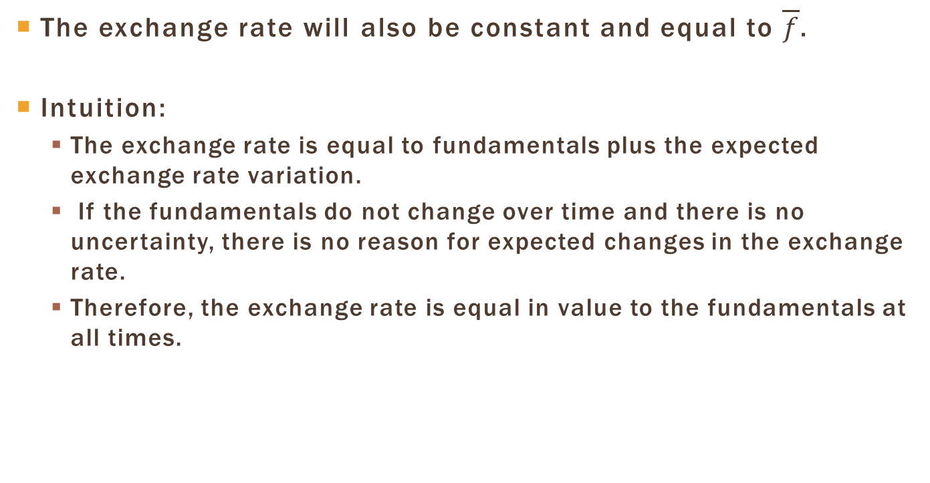
Example: Constant Fundamentals
The exchange rate will also be constant and equal to $\overline{f}$.
Intuition:
  The exchange rate is equal to fundamentals plus the expected exchange rate variation.
  If the fundamentals do not change over time and there is no uncertainty, there is no reason for expected changes in the exchange rate.
  Therefore, the exchange rate is equal in value to the fundamentals at all times.

Slide 25
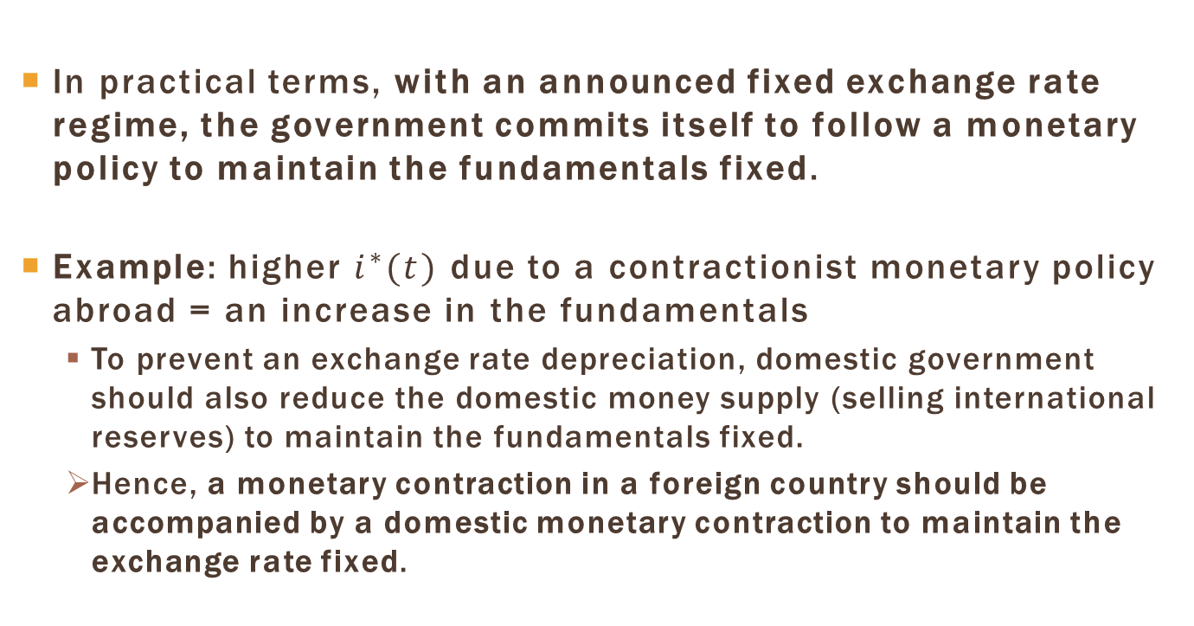
Fundamentals and
Fixed Exchange Rate
In practical terms, with an announced fixed exchange rate regime, the government commits itself to follow a monetary policy to maintain the fundamentals fixed.
Example: higher $i^{∗}(t)$ due to a contractionist monetary policy abroad = an increase in the fundamentals
  To prevent an exchange rate depreciation, domestic government should also reduce the domestic money supply (selling international reserves) to maintain the fundamentals fixed.
  Hence, a monetary contraction in a foreign country should be accompanied by a domestic monetary contraction to maintain the exchange rate fixed.

Slide 26
Example: Constant Fundamentals
There may be uncertainty in relation to the maintenance of the fixed exchange rate regime.
Example: a country with high unemployment that follows a fixed exchange rate regime
  Temptation to abandon the fixed exchange rate regime in order to use monetary policy to stimulate the economy
  A positive probability is attributed to an increase in the future fundamentals => expectation of exchange rate depreciation.
  To maintain a fixed exchange rate, the government must practice an even more restrictive monetary policy.
  This means that the cost of maintaining the exchange rate fixed is higher the greater the lack of confidence in relation to the regime.

Slide 27
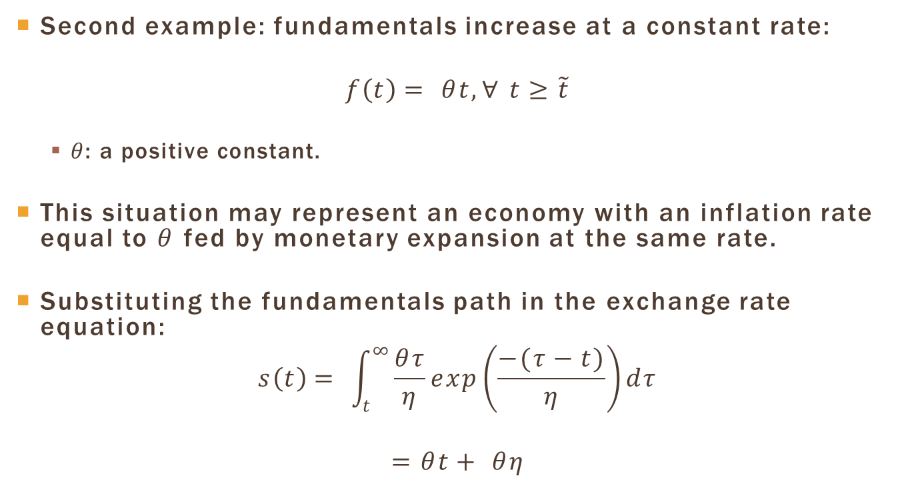
Example: Fundamentals Increasing at a Constant Rate
Second example: fundamentals increase at a constant rate:
$$f\left(t\right)= θt, ∀ t≥\tilde{t}$$
  $θ$: a positive constant.
This situation may represent an economy with an inflation rate equal to $θ$ fed by monetary expansion at the same rate.
Substituting the fundamentals path in the exchange rate equation:
$$s\left(t\right)= \int_{t}^{∞}{\frac{θτ}{η}exp\left(\frac{−(τ−t)}{η}\right)dτ}$$
$$=θt+ θη$$

Slide 28
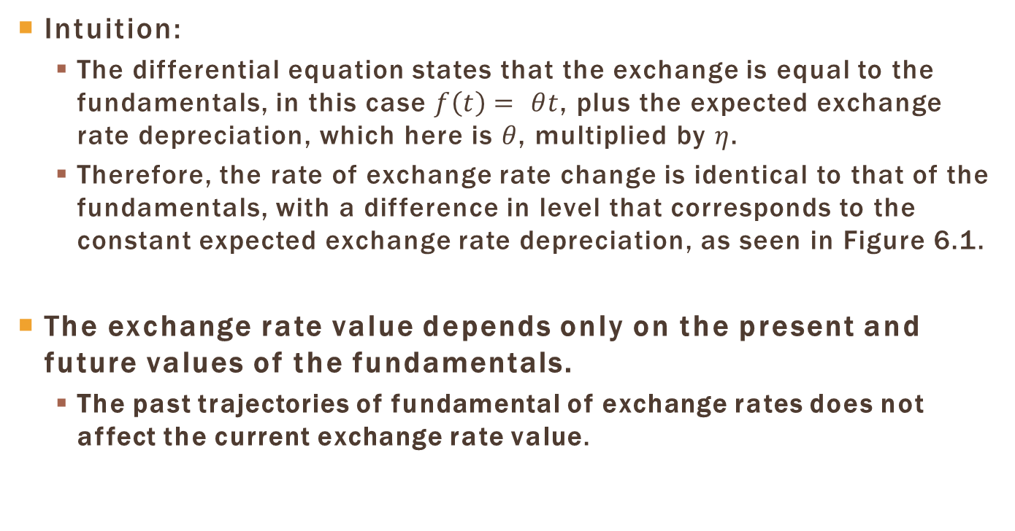
Increasing Fundamentals: Intuition
Intuition:
  The differential equation states that the exchange is equal to the fundamentals, in this case $f\left(t\right)= θt$, plus the expected exchange rate depreciation, which here is $θ$, multiplied by $η$.
  Therefore, the rate of exchange rate change is identical to that of the fundamentals, with a difference in level that corresponds to the constant expected exchange rate depreciation, as seen in Figure 6.1.
The exchange rate value depends only on the present and future values of the fundamentals.
  The past trajectories of fundamental of exchange rates does not affect the current exchange rate value.

Slide 29
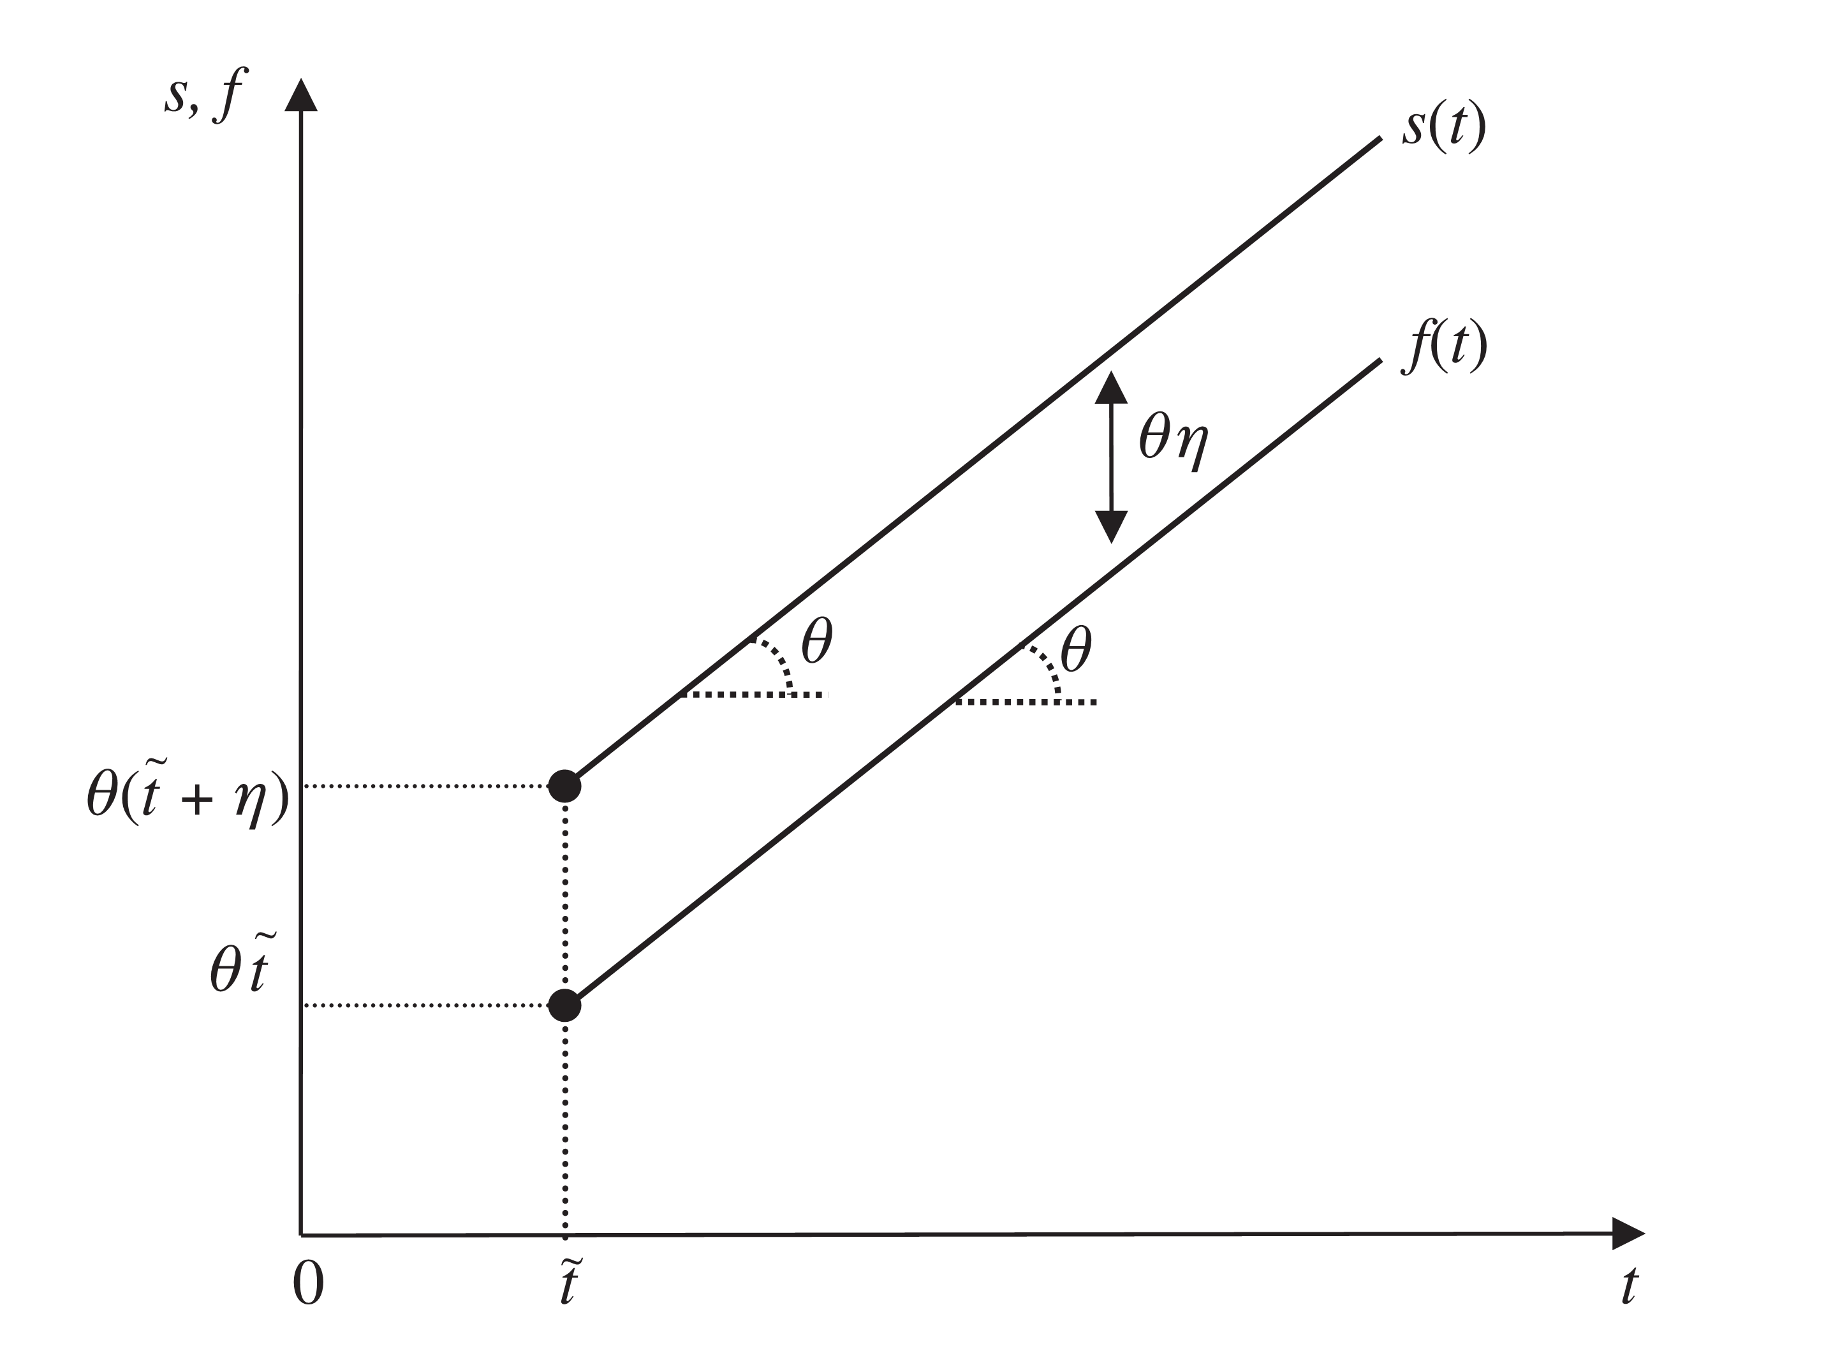
Exchange rate and
Fundamentals Paths

Slide 30
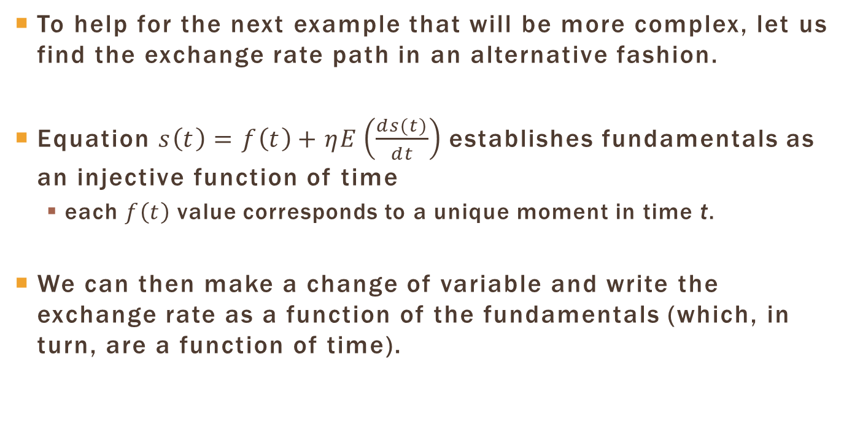
Another way to solve the model
To help for the next example that will be more complex, let us find the exchange rate path in an alternative fashion.
Equation $s\left(t\right)=f\left(t\right)+ηE\left(\frac{ds(t)}{dt}\right)$ establishes fundamentals as an injective function of time
  each $f\left(t\right)$ value corresponds to a unique moment in time t.
We can then make a change of variable and write the exchange rate as a function of the fundamentals (which, in turn, are a function of time).

Slide 31
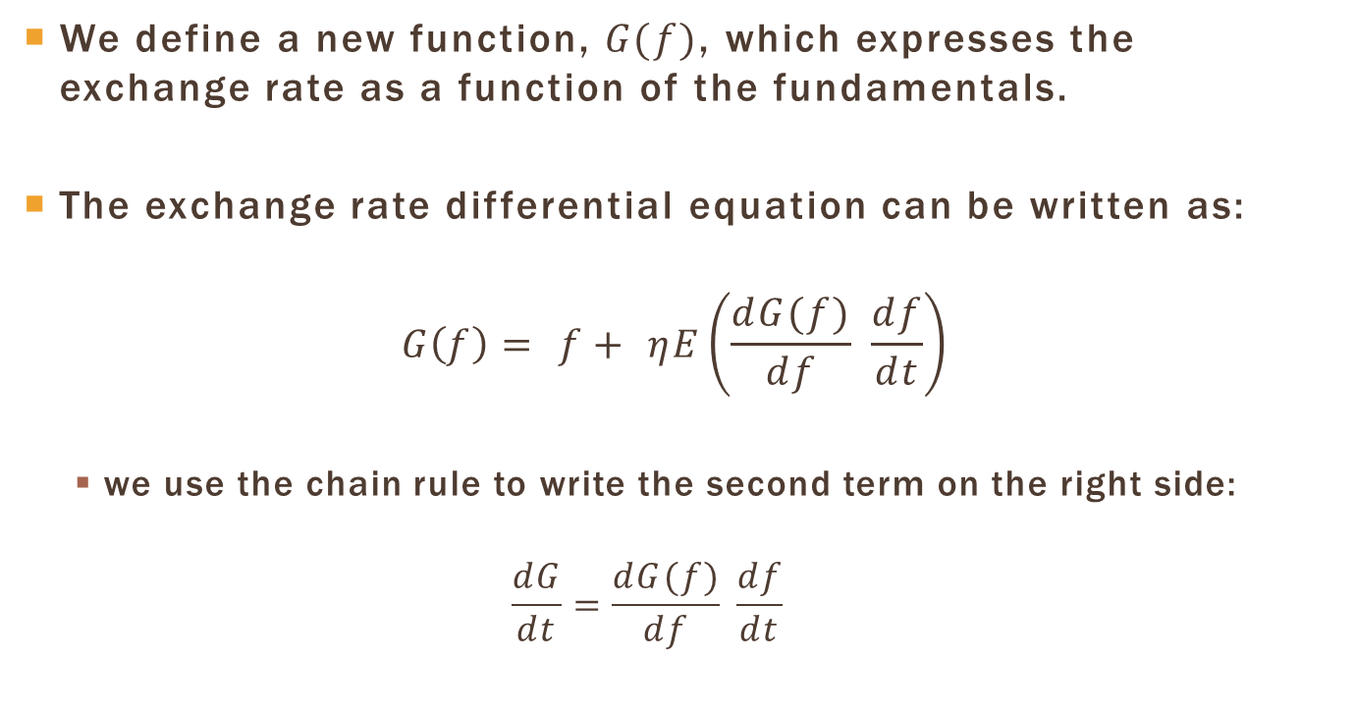
Change of Variable
We define a new function, $G(f)$, which expresses the exchange rate as a function of the fundamentals.
The exchange rate differential equation can be written as:
$$G\left(f\right)= f+ ηE\left(\frac{dG(f)}{df} \frac{df}{dt}\right)$$
  we use the chain rule to write the second term on the right side:
  $$\frac{dG}{dt}=\frac{dG(f)}{df} \frac{df}{dt}$$

Slide 32
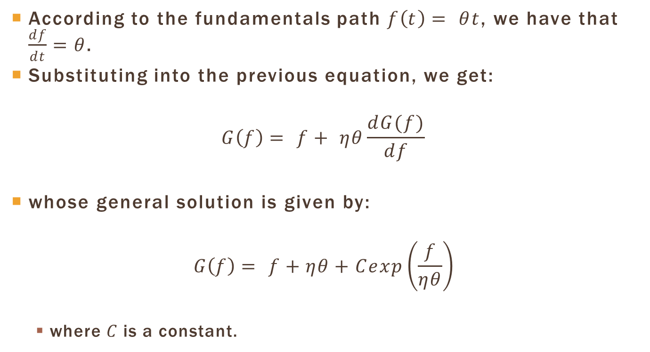
General Solution
According to the fundamentals path $f\left(t\right)= θt$, we have that $\frac{df}{dt}=θ$.
Substituting into the previous equation, we get:
$$G\left(f\right)= f+ ηθ\frac{dG(f)}{df}$$
whose general solution is given by:
$$G\left(f\right)= f+ηθ+Cexp\left(\frac{f}{ηθ}\right)$$
  where $C$ is a constant.

Slide 33
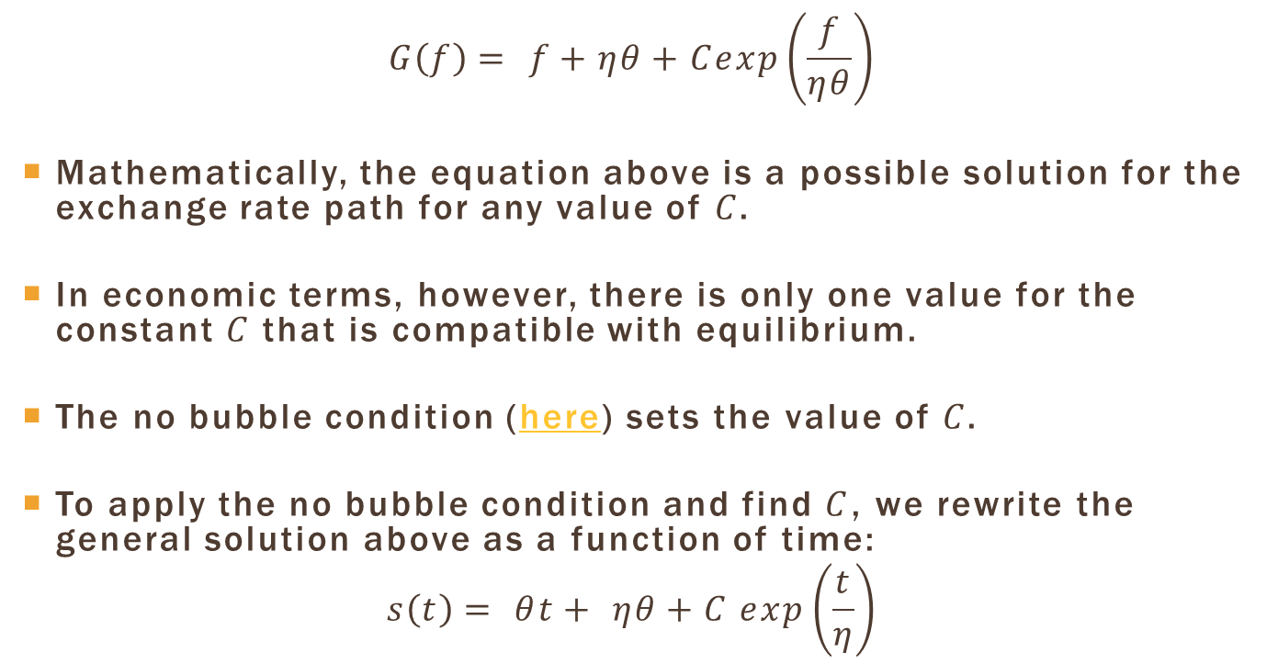
No Bubble Condition
$$G\left(f\right)= f+ηθ+Cexp\left(\frac{f}{ηθ}\right)$$
Mathematically, the equation above is a possible solution for the exchange rate path for any value of $C$.
In economic terms, however, there is only one value for the constant $C$ that is compatible with equilibrium.
The no bubble condition (here) sets the value of $C$.
To apply the no bubble condition and find $C$, we rewrite the general solution above as a function of time:
$$s\left(t\right)= θt+ ηθ+C exp\left(\frac{t}{η}\right)$$

Slide 34
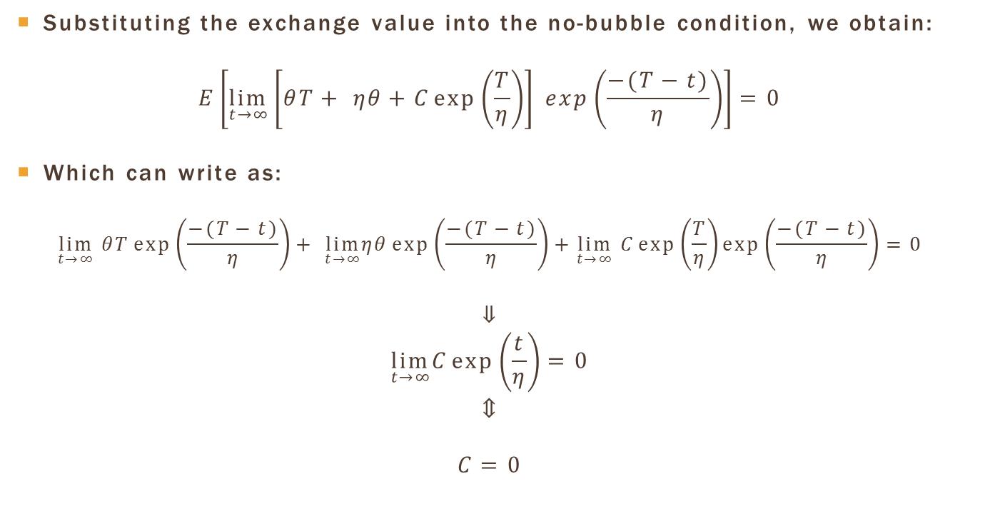

Finding $C$
Substituting the exchange value into the no-bubble condition, we obtain:
$$E\left[\lim_{t→∞}\left[θT+ ηθ+C\exp\left(\frac{T}{η}\right)\right] exp\left(\frac{−(T−t)}{η}\right)\right]=0$$
Which can write as:
$$\lim_{t→∞} θT\exp\left(\frac{−(T−t)}{η}\right)+ \lim_{t→∞}ηθ\exp\left(\frac{−(T−t)}{η}\right)+\lim_{t→∞} C\exp\left(\frac{T}{η}\right)\exp\left(\frac{−(T−t)}{η}\right)=0$$
$$⇓$$
$$\lim_{t→∞}C\exp\left(\frac{t}{η}\right)=0$$
$$⇕$$
$$C=0$$

Slide 35
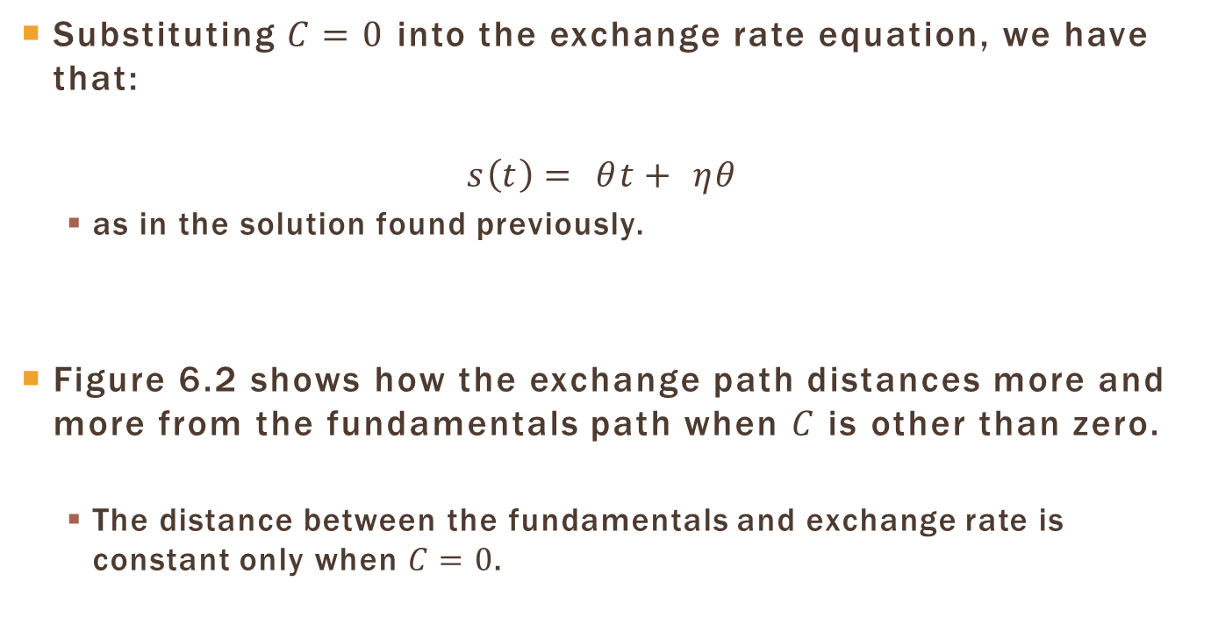
Solution
Substituting $C=0$ into the exchange rate equation, we have that:
$$s\left(t\right)= θt+ ηθ$$
  as in the solution found previously.
Figure 6.2 shows how the exchange path distances more and more from the fundamentals path when $C$ is other than zero.
  The distance between the fundamentals and exchange rate is constant only when $C=0$.

Slide 36
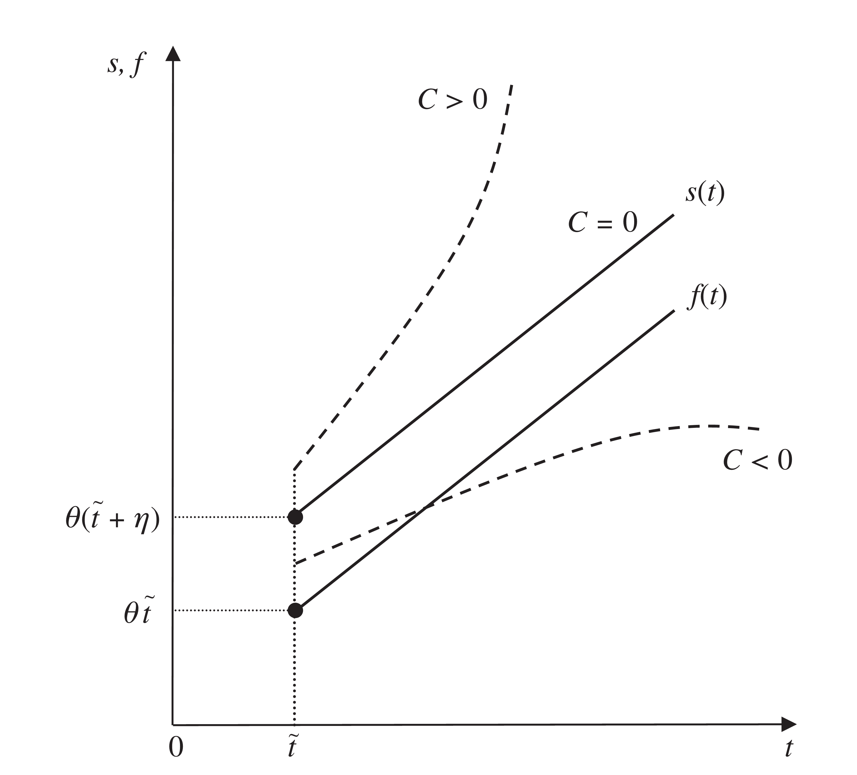

Exchange and Fundamentals Paths: Different Values of $C$

Slide 37
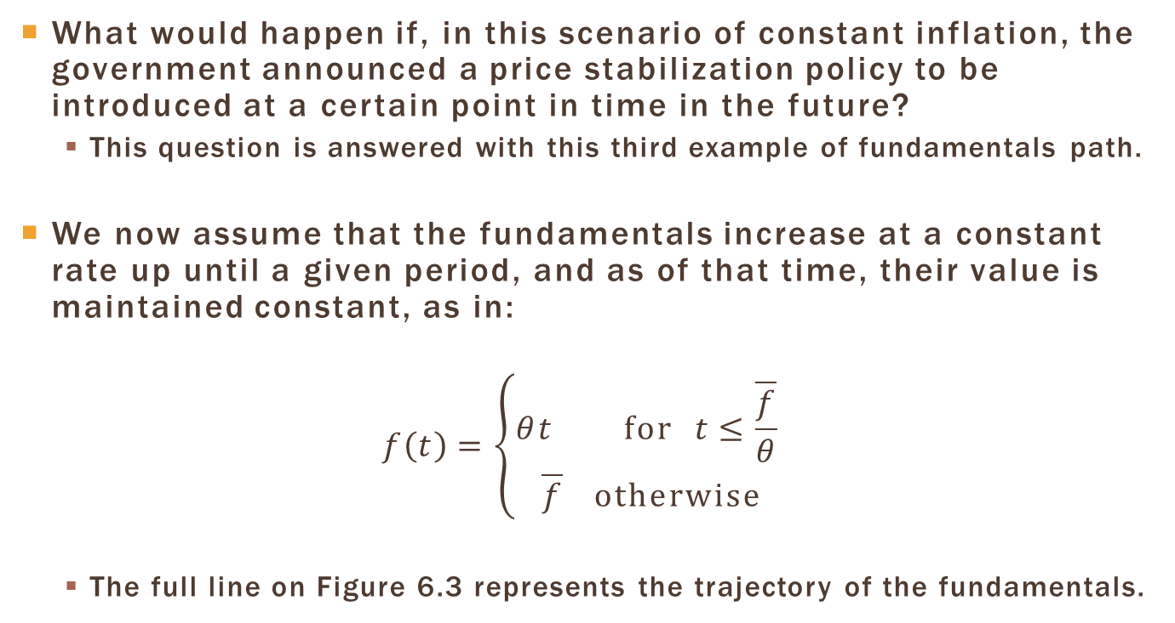
Fundamentals Increase and then Remain Constant
What would happen if, in this scenario of constant inflation, the government announced a price stabilization policy to be introduced at a certain point in time in the future?
  This question is answered with this third example of fundamentals path.
We now assume that the fundamentals increase at a constant rate up until a given period, and as of that time, their value is maintained constant, as in:
$$f\left(t\right)=\left\{\begin{aligned}θt for t≤\frac{\overline{f}}{θ} \\ \overline{f} otherwise\end{aligned}\right.$$
  The full line on Figure 6.3 represents the trajectory of the fundamentals.

Slide 38
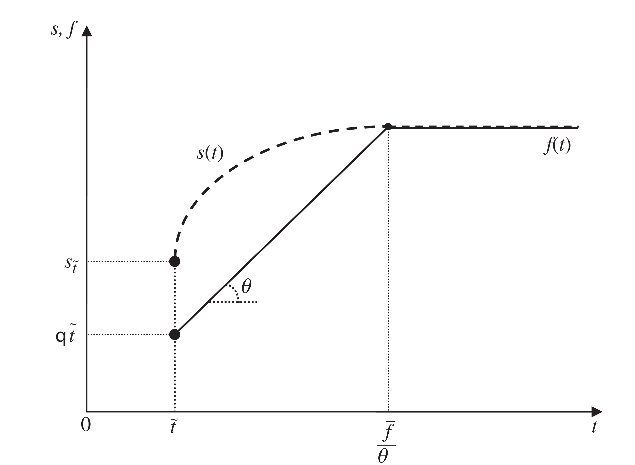
Fundamentals Increase and then Remain Constant

Slide 39
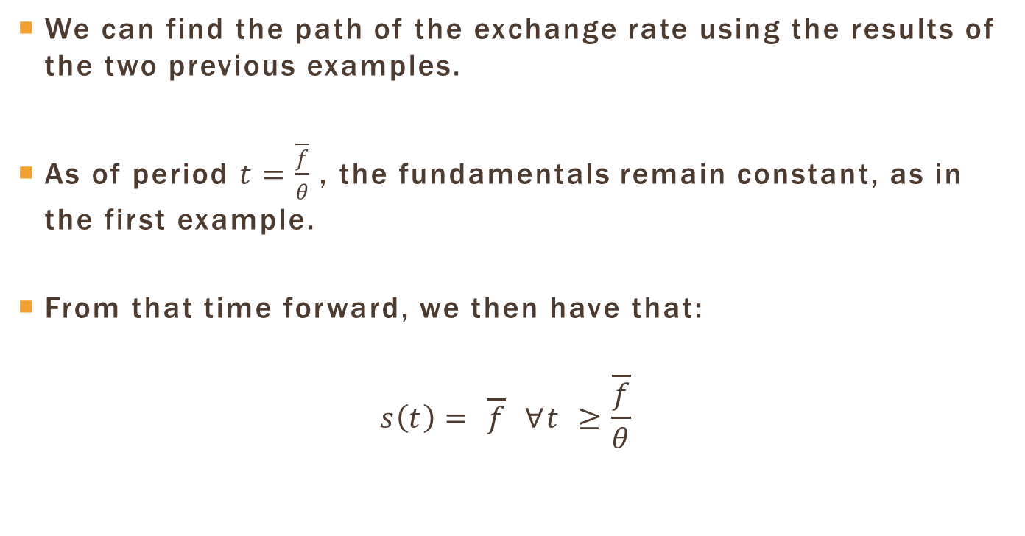
When Fundamentals are Constant
We can find the path of the exchange rate using the results of the two previous examples.
As of period $t=\frac{\overline{f}}{θ}$, the fundamentals remain constant, as in the first example.
From that time forward, we then have that:
$$s\left(t\right)= \overline{f} ∀t ≥\frac{\overline{f}}{θ}$$

Slide 40
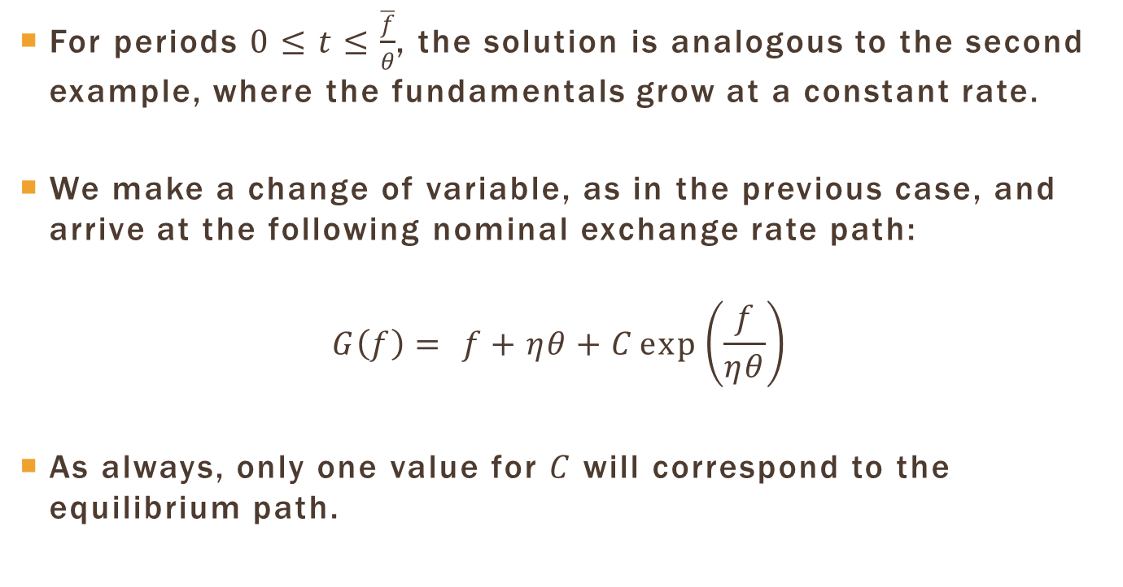
While Fundamentals are Increasing
For periods $0≤t≤\frac{\overline{f}}{θ}$, the solution is analogous to the second example, where the fundamentals grow at a constant rate.
We make a change of variable, as in the previous case, and arrive at the following nominal exchange rate path:
$$G\left(f\right)= f+ηθ+C\exp\left(\frac{f}{ηθ}\right)$$
As always, only one value for $C$ will correspond to the equilibrium path.

Slide 41
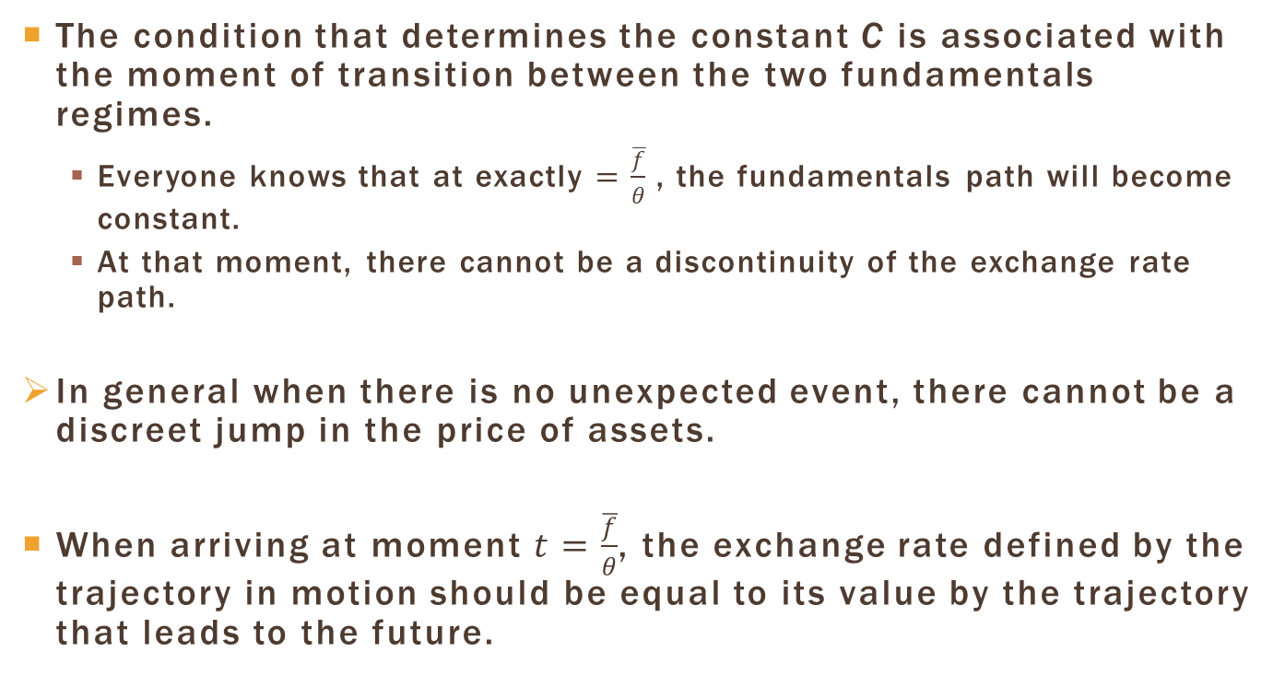
Finding $C$
The condition that determines the constant C is associated with the moment of transition between the two fundamentals regimes.
  Everyone knows that at exactly $=\frac{\overline{f}}{θ}$ , the fundamentals path will become constant.
  At that moment, there cannot be a discontinuity of the exchange rate path.
In general when there is no unexpected event, there cannot be a discreet jump in the price of assets.
When arriving at moment $t=\frac{\overline{f}}{θ}$, the exchange rate defined by the trajectory in motion should be equal to its value by the trajectory that leads to the future.

Slide 42
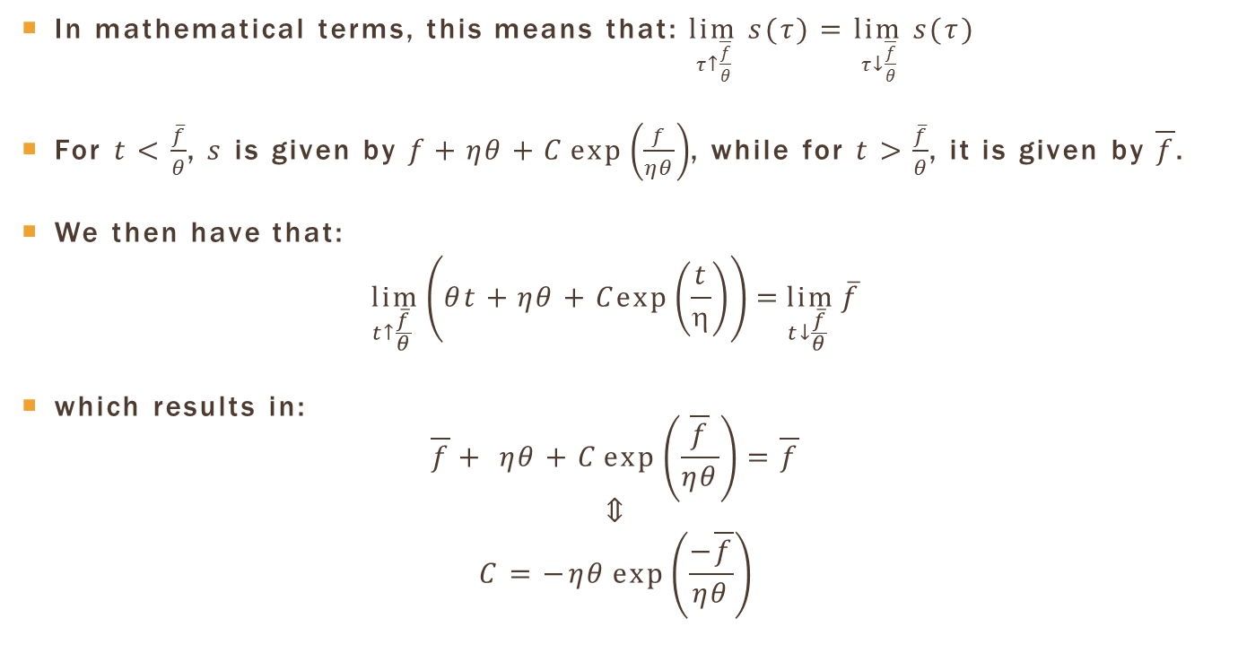
Finding $C$
In mathematical terms, this means that: $\lim_{τ↑\frac{\overline{f}}{θ}} s(τ)=\lim_{τ↓\frac{\overline{f}}{θ}} s(τ)$
For $t<\frac{\overline{f}}{θ}$, $s$ is given by $f+ηθ+C\exp\left(\frac{f}{ηθ}\right)$, while for $t>\frac{\overline{f}}{θ}$, it is given by $\overline{f}$.
We then have that:
$$\lim_{t↑\frac{\overline{f}}{θ} }\left(θt+ηθ+Cexp\left(\frac{t}{η}\right)\right)=\lim_{t↓\frac{\overline{f}}{θ} }{\overline{f}}$$
which results in:
$$\overline{f}+ ηθ+C\exp\left(\frac{\overline{f}}{ηθ}\right)=\overline{f}$$
$$⇕$$
$$C=−ηθ\exp\left(\frac{−\overline{f}}{ηθ}\right)$$

Slide 43
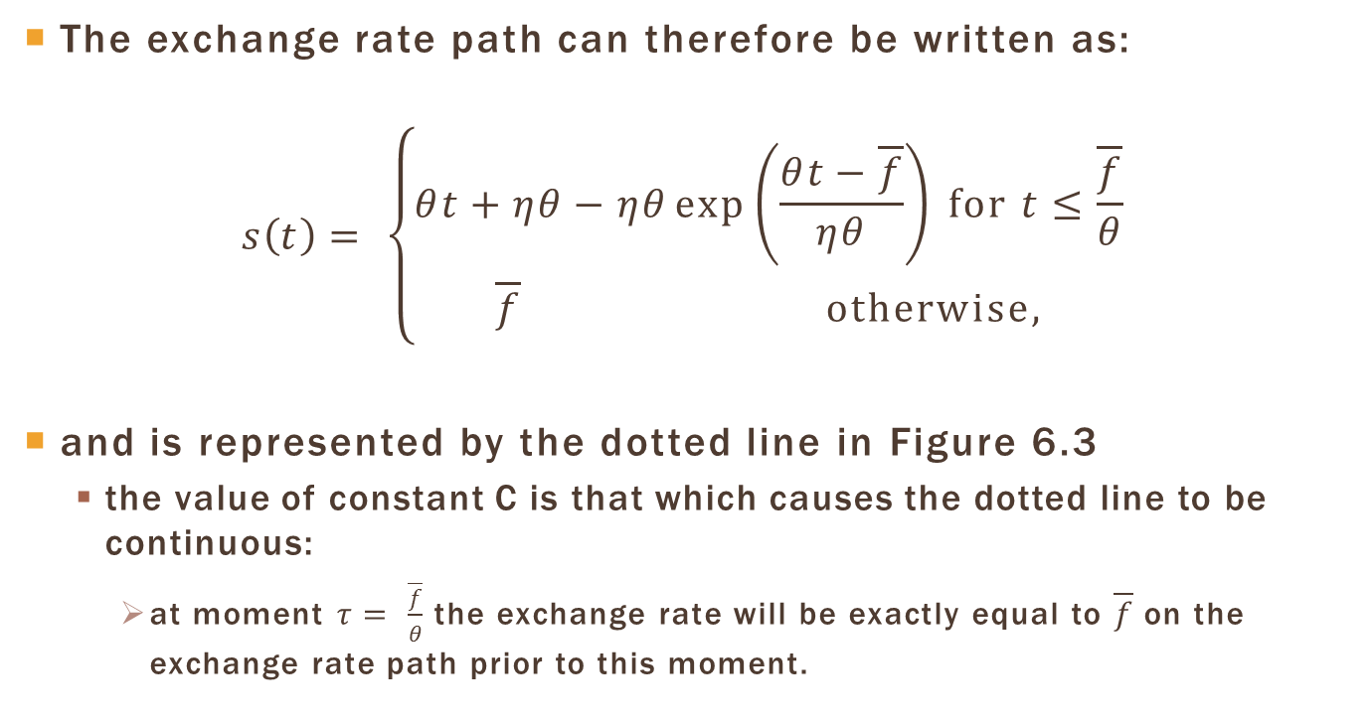
The exchange rate path
The exchange rate path can therefore be written as:
$$s\left(t\right)= \left\{\begin{aligned}θt+ηθ−ηθ\exp\left(\frac{θt−\overline{f}}{ηθ}\right) for t≤\frac{\overline{f}}{θ} \\ \overline{f} otherwise,\end{aligned}\right.$$
and is represented by the dotted line in Figure 6.3
  the value of constant C is that which causes the dotted line to be continuous:
    at moment $τ= \frac{\overline{f}}{θ}$ the exchange rate will be exactly equal to $\overline{f}$ on the exchange rate path prior to this moment.

Slide 44
Exchange Rate and
Fundamentals Paths

Slide 45
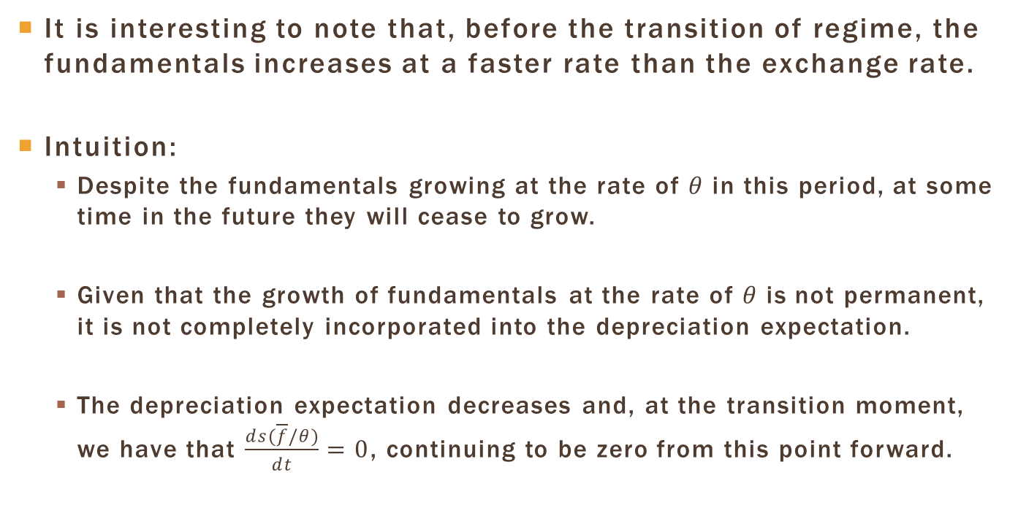
Exchange Rate and Fundamentals
It is interesting to note that, before the transition of regime, the fundamentals increases at a faster rate than the exchange rate.
Intuition:
  Despite the fundamentals growing at the rate of $θ$ in this period, at some time in the future they will cease to grow.
  Given that the growth of fundamentals at the rate of $θ$ is not permanent, it is not completely incorporated into the depreciation expectation.
  The depreciation expectation decreases and, at the transition moment, we have that $\frac{ds(\overline{f}/θ)}{dt}=0$, continuing to be zero from this point forward.

Slide 46
Plan
Money, Assets, and Goods Markets
  Money Market
  Assets Market
  Goods Market
Exchange Rate Fundamentals
  Constant Fundamentals
  Fundamentals Increasing at a Constant Rate
  Fundamentals That Increase and Then Remain Constant
Applications, Extensions, and Limits of the Model

Slide 47
Applications, Extensions and
Limits of the Model
The monetary model with flexible prices:
  study the impact of fundamentals on the nominal exchange rate
  shows how monetary policy affects the exchange rate and how it should be used to attain exchange rate goals
  explains the role of future expectations on the current exchange rate.
This model was useful to understand the effects a regime of exchange rate target zones
  where the government commits to maintain the exchange rate within previously established limits.

Slide 48
Applications, Extensions and
Limits of the Model
Krugman (1991): exchange rate target zones have a stabilizing effect known as the honeymoon effect.
  the impact of fundamentals on the exchange rate reduced as it neared the pre-established limits of the exchange rate band.
  This honeymoon effect is generated by the impact of the expectations on the exchange rate path, as in our last case studied, where the fundamentals initially increased and then remained constant.

Slide 49
Applications, Extensions and
Limits of the Model
The monetary model with flexible prices does not help in understanding the relation between the exchange rate and the real side of the economy.
Complete price flexibility => prices adjust immediately to any movement in the nominal exchange rate => the real exchange rate is always constant.
Changes in the nominal exchange rate affect neither the output level nor the trade balance.
This model should be seen as a long-term representation, where prices have had time to adjust to exchange rate changes.

